Slide 1
Longevity Risk Management and Static Hedging for Life and Variable Annuities
Sixth International Longevity Risk and Capital Markets Solutions Conference
Sydney Australia
9 and 10 September 2010
Michael Sherris (with Andrew Ngai)
Australian School of Business, UNSW

Slide 2
Overview
Longevity Risk
Life annuities and hedging instruments
Market and mortality models
Hedging strategies and effectiveness using Longevity Bonds and Derivatives
Basis risk and market price of longevity risk

Slide 3
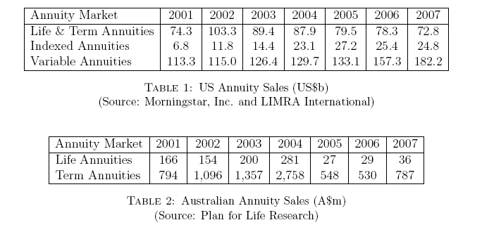
Longevity Products - Retail
Life Annuities, Deferred Annuities, Variable Annuities (+GLWB)

Slide 4
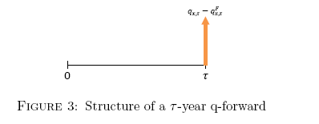
Longevity hedging: q-Forwards
  Pay actual (population) q_{x,t} in exchange for agreed fixed q^{F}_{x,t}
  Individual ages and 5-yr Bucketed

Slide 5
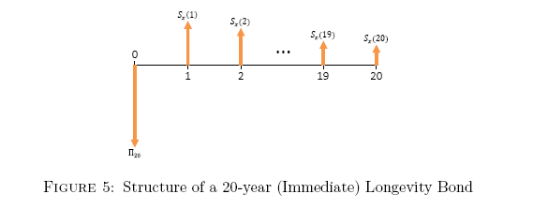
Longevity hedging: Coupon Longevity Bond
  Payments in line with actual survival probability S₆₅(t)

Slide 6
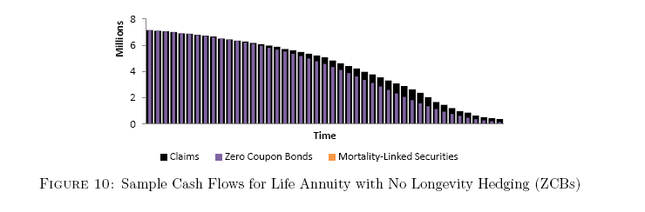
Static Hedging – ALM
ALM interest rate risk only
Simulated payments for static hedged portfolio

Slide 7
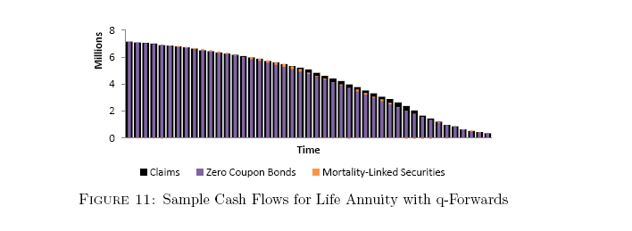
Static Hedging
ALM with longevity derivatives

Slide 8
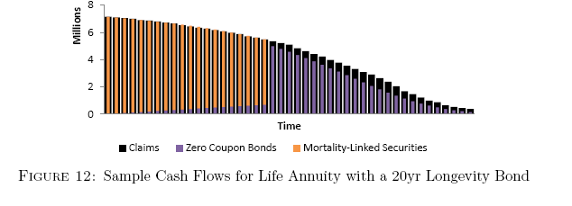
Static Hedging
ALM with 20 year longevity bonds

Slide 9
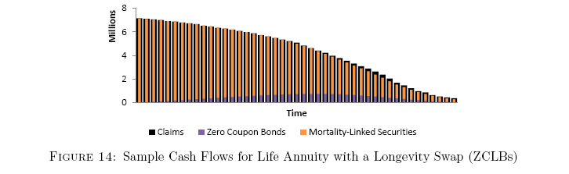
Static Hedging
ALM with longevity swap

Slide 10
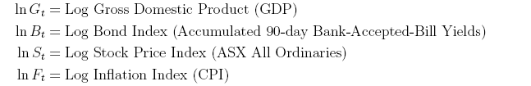
Market Model – Economic Scenario Generator
Vector Error Correction Model with Regime Switching (RS-VECM)
Long run equilibrium, volatility regimes

Slide 11
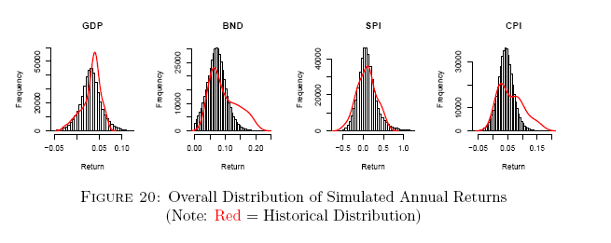
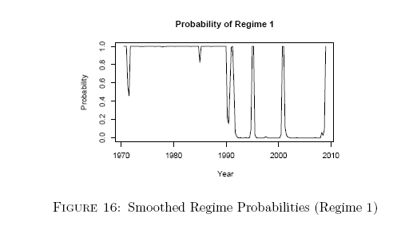
Market model

Slide 12

Mortality Model
Models mortality rates in cohort direction
Logit age structure for rate changes (stationary)
Age dependence using principal components (errors are not iid)

Slide 13
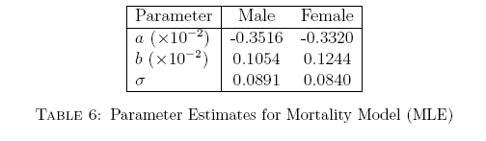
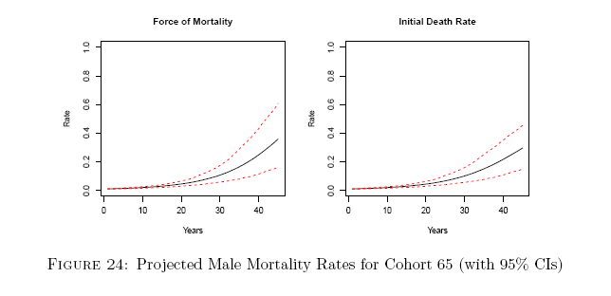
Mortality Model

Slide 14


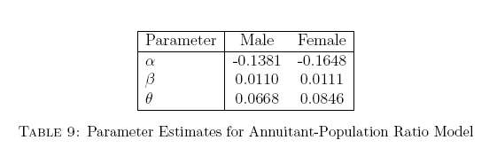
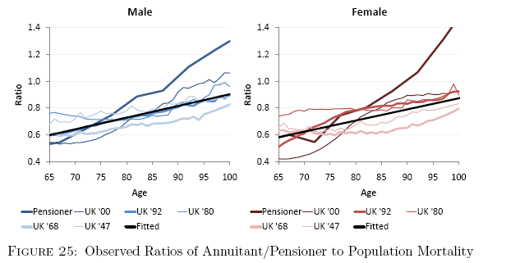
Mortality Basis Risk
Portfolio of annuitants – hedging instruments based on population index

Slide 15
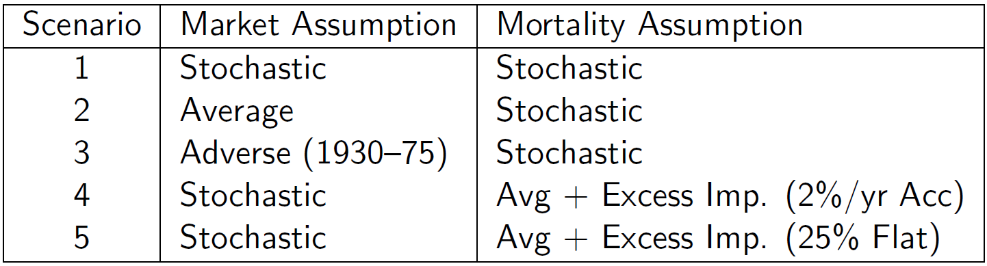
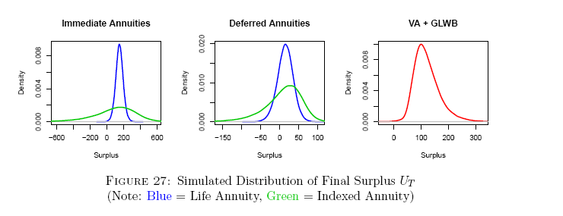
Scenarios

Slide 16
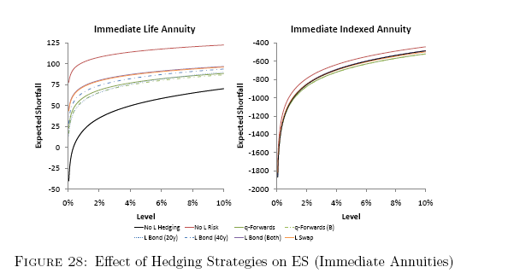
Shortfall risk – Life annuities
Inflation indexed annuities have substantial shortfall risk from uncertain future inflation

Slide 17
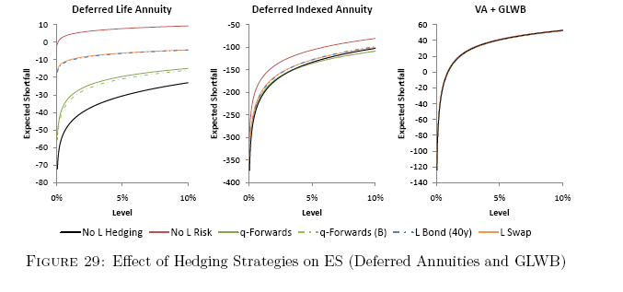
Shortfall risk – Deferred Life annuities + GLWB
VA + GLWB provides limited longevity protection – hedging has little impact

Slide 18
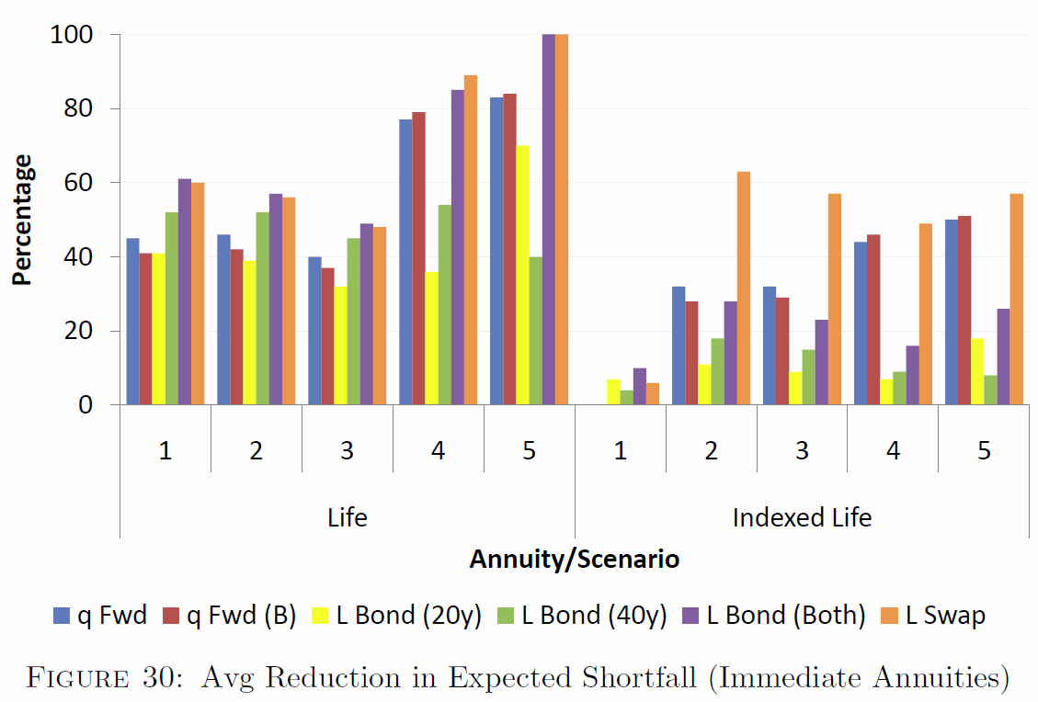
Scenarios – Annuities (Life/Indexed)

Slide 19
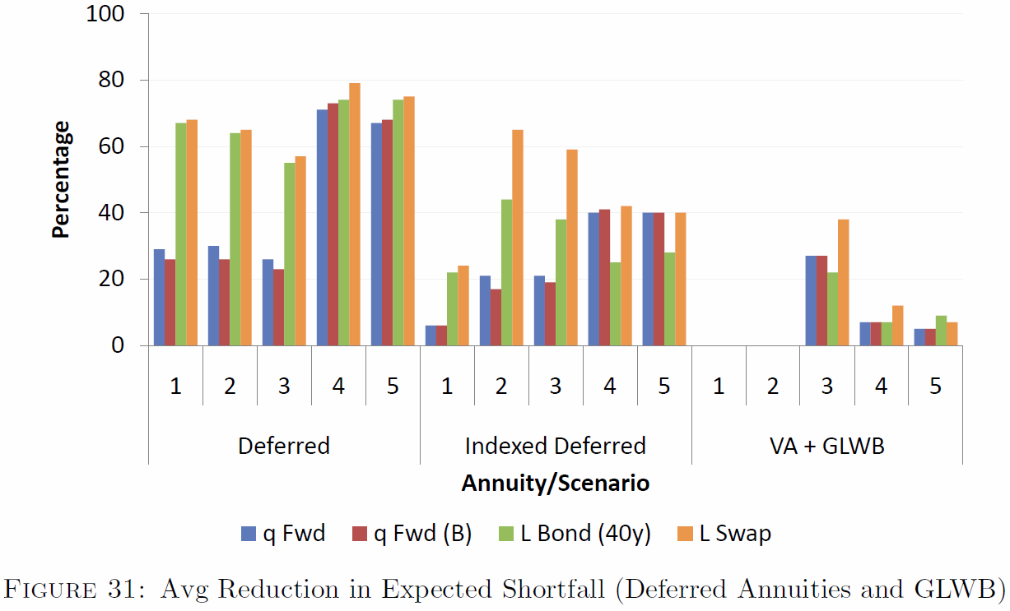
Scenarios – Deferred Annuities + GLWB

Slide 20
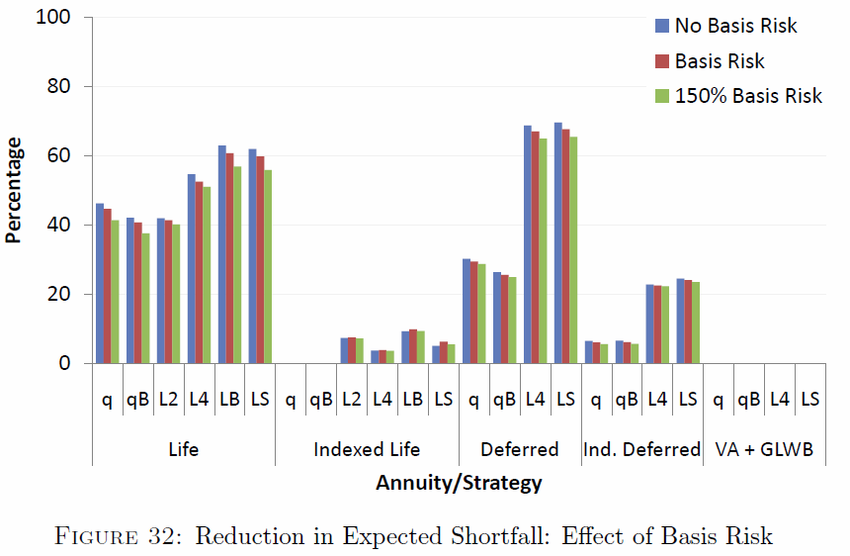
Basis Risk and Hedging Effectiveness

Slide 21
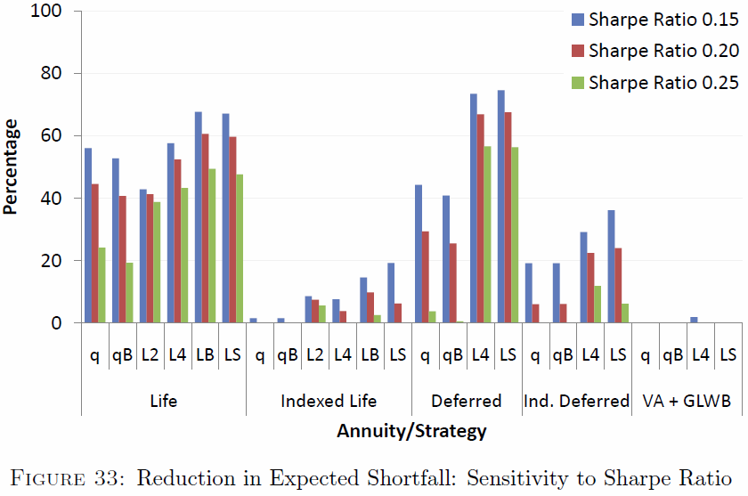
Hedging Cost and Hedge Effectiveness

Slide 22
Summary and Main Conclusions
Static hedging (ALM) strategies reduce longevity risk particularly for life annuities (immediate and deferred)
Much less effective for inflation indexed annuities (inflation risk predominates)
VA with GLWB provides limited longevity protection and longevity hedging is of little value
q-Forwards have additional basis risk over longevity bonds (mortality rates vs survival probabilities)
Basis risk (annuitant vs population, bucketing) not critical for hedge effectiveness
Cost of hedging (price of longevity risk) is an important factor for hedge effectiveness (both derivatives and longevity bonds)

