Slide 1
Spatial Variability in Mortality and Socioeconomic Factors for Australian Mortality
Sixth International Longevity Risk and Capital Markets Solutions Conference
Sydney Australia
9 and 10 September 2010
Michael Sherris (with Andy Tang)
Australian School of Business, UNSW

Slide 2
Introduction
Mortality rates are known to vary by geographical location and to depend on socio-economic factors.
Demographic, ethnic and socio-economic mortality factors vary by geographical location.
Spatial variability of Australian mortality is assessed using a spatial model along with explanatory risk factors including age, income, labour force participation and unemployment rate.

Slide 3
Introduction
Spatial models explain mortality variation by geographical location better than non-spatial models when limited data is available for socio-economic factors.
Explanatory factors, which also vary spatially, reduce the need for spatial models for mortality.

Slide 4
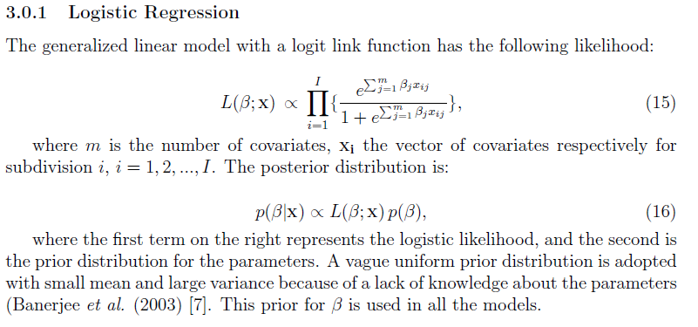
Logistic regression

Slide 5
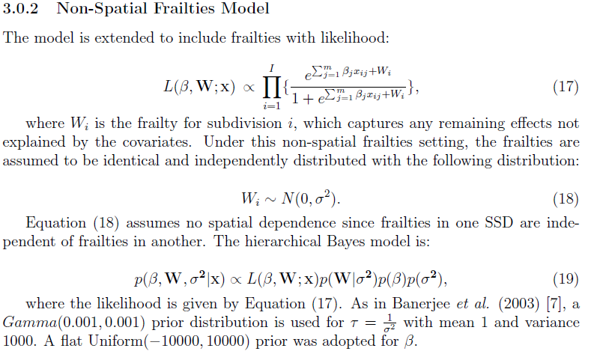
Non-spatial frailties model

Slide 6
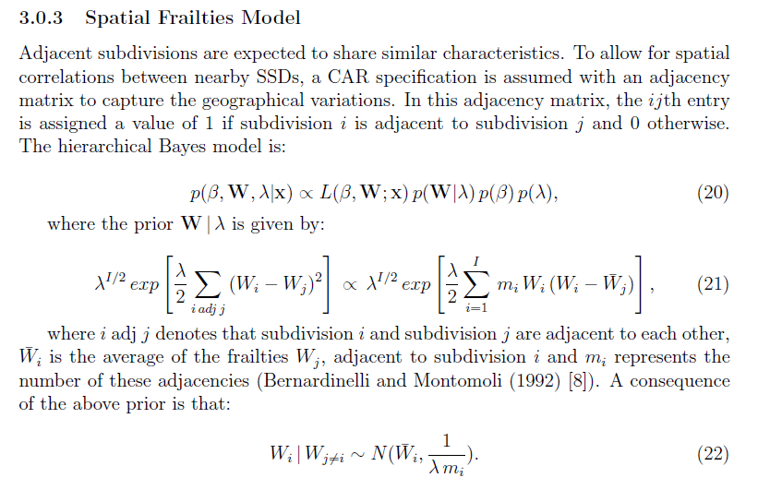
Spatial frailties model

Slide 7
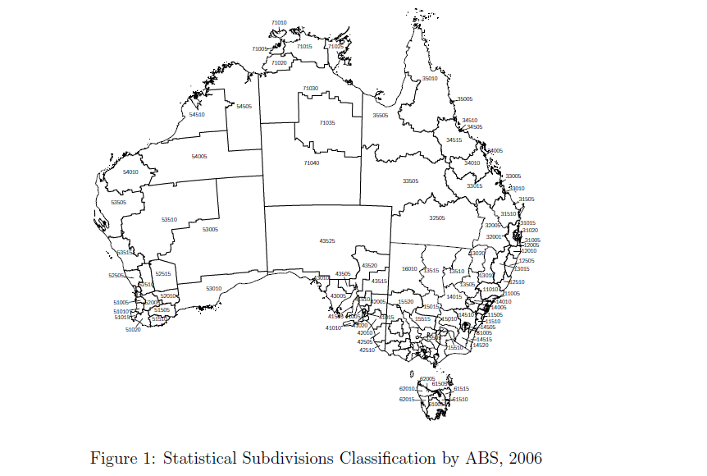
Data – SSD’s

Slide 8
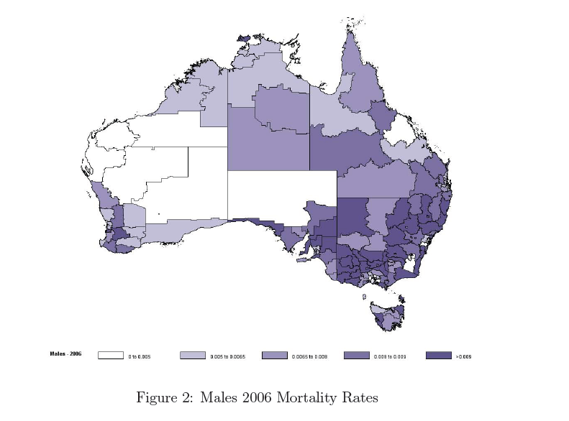
Data – mortality rates

Slide 9
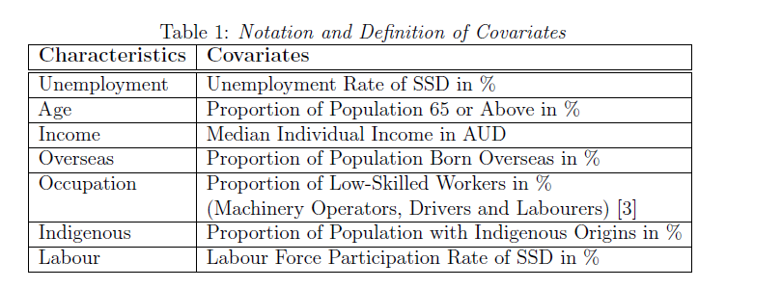
Covariates

Slide 10
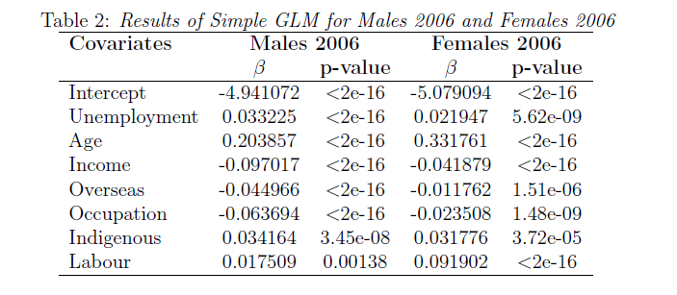
Results - GLM

Slide 11
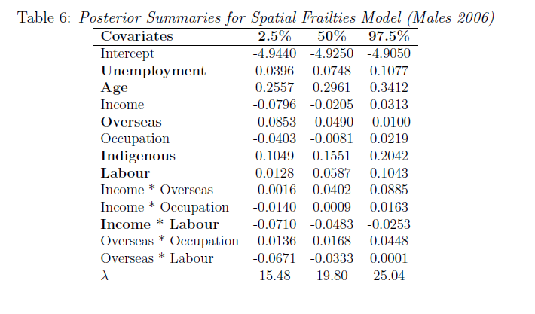
Spatial Frailties Model

Slide 12
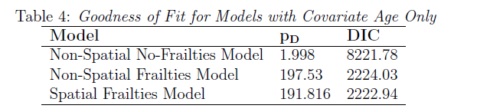
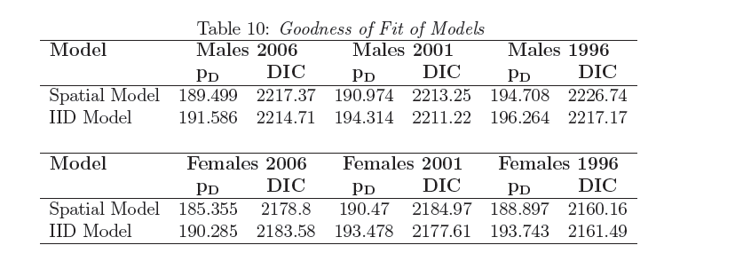
Model Comparison

Slide 13
Summary and Main Conclusions
Explanatory factors for mortality are spatially distributed
Spatial models are useful in understanding mortality variation if information about factors is not available
Implications for risk rating of longevity products – postcode, geographical factors – especially when risk factors data is limited.

